Slide 1

Digital Marketing Plan for Glen Group of Companies
Srijan Mishra

Slide 2
TABLE OF CONTENTS
01
02
03
04
06
Website Analysis
Social Media Analysis
Target
Audience
Strategy
Resources

Slide 3
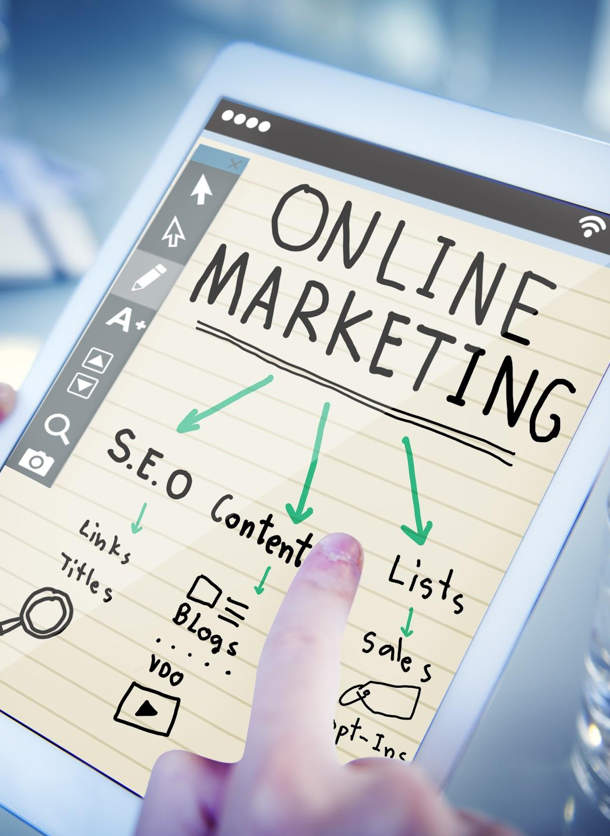
Goal & Objective
Some of the basic goals include:
Generating organic traffic
Generating more quality leads
Building brand awareness and digital presence
Build brand authority
Explore new platforms to generate leads

Slide 4
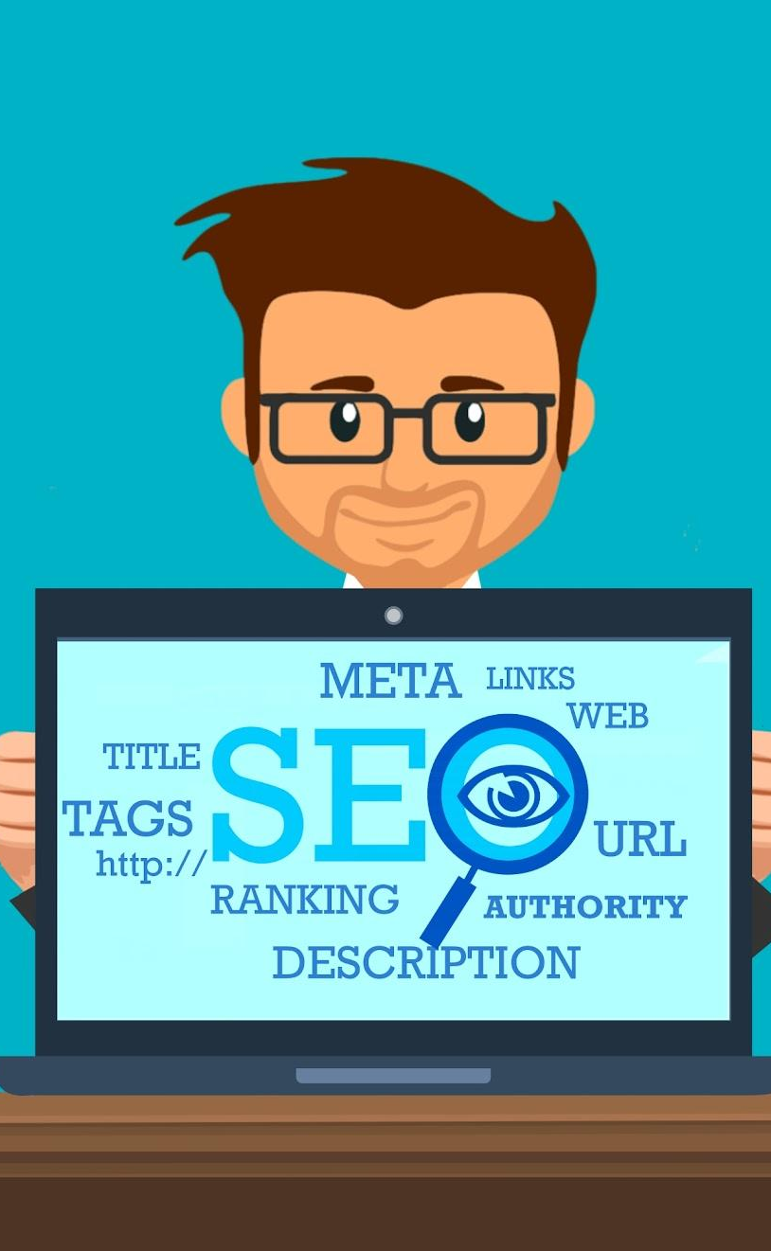
01
Website Analysis

Slide 5
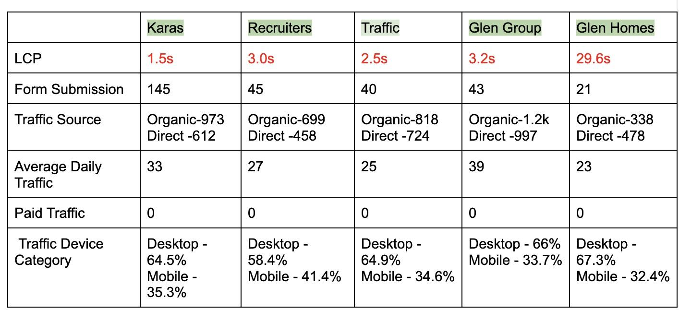
Data Provided

Slide 6
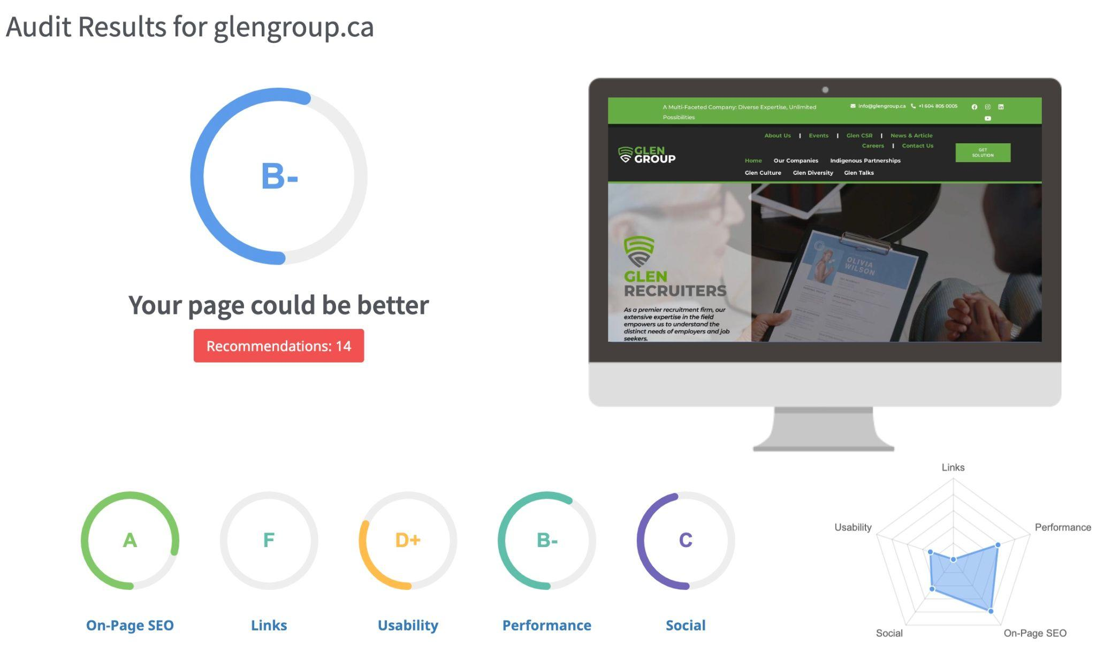
Glen Group of Companies: glengroup.ca
Strengths and Analysis
Clear Value Proposition: The website clearly communicates Glen Group's diverse range of services across various industries, emphasizing their commitment to client success and long-term relationships.
Easy Navigation: The website structure is straightforward, with intuitive menus and quick access to relevant information for each subsidiary.
Mobile-Friendly Design: The website adapts well to mobile devices, ensuring accessibility and usability on various platforms.
Contact Information: Contact details are readily available on various pages, including individual subsidiary pages and a dedicated contact form.
Social Proof: Testimonials and client logos add credibility and trust to the company's image.
Please click on the image above for a detailed report.

Slide 7
Glen Group of Companies: glengroup.ca
Scope of Improvement
Website Speed: Page loading times could be improved, especially for mobile users. Consider optimizing images and implementing caching mechanisms.
Content Depth: While the overall message is clear, some sections lack detailed information about specific services offered by each subsidiary. Consider adding case studies, project examples, or service brochures to showcase expertise.
Visual Appeal: The website's design, while functional, could benefit from a more modern and engaging aesthetic. Consider incorporating fresh visuals, bolder fonts, and color palettes that align with the company's brand identity.
SEO Optimization: While keywords are present, the website could benefit from further optimization for relevant search terms. Consider implementing proper meta descriptions, title tags, and internal linking strategies.
Call to Action: Make calls to action more prominent and persuasive throughout the website. Encourage users to contact for quotes, schedule consultations, or download informative resources.
Additional Notes:
The "Hiring Fairs" and "Events" sections appear outdated, lacking information or links to current events.
Consider incorporating blog posts or news articles to demonstrate expertise and attract organic traffic.

Slide 8
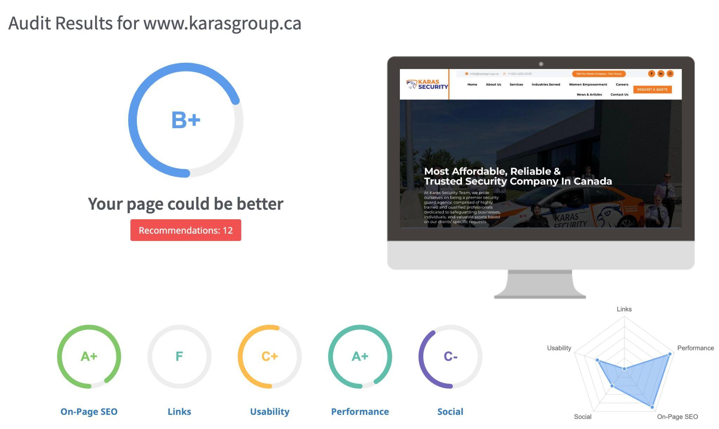
Karas Security: karasgroup.ca
Strengths and Analysis
Compelling Value Proposition: The website effectively highlights Karas Security's commitment to personalized security solutions and client safety, emphasizing their focus on trained and qualified professionals.
Clear Service Overview: Services are presented succinctly and categorized, simplifying navigation for potential clients.
Strong Calls to Action: Prominent calls to action encourage users to request quotes, contact for inquiries, or explore career opportunities..
Visual Content: Images and videos effectively showcase the security personnel in action, adding a human touch and realism.
Mobile-Friendly Design: The website adapts well to various screen sizes, ensuring accessibility on mobile devices.
Please click on the image above for a detailed report.

Slide 9
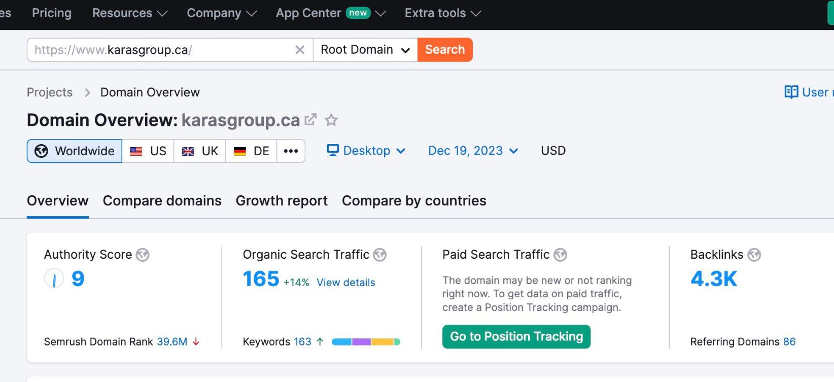
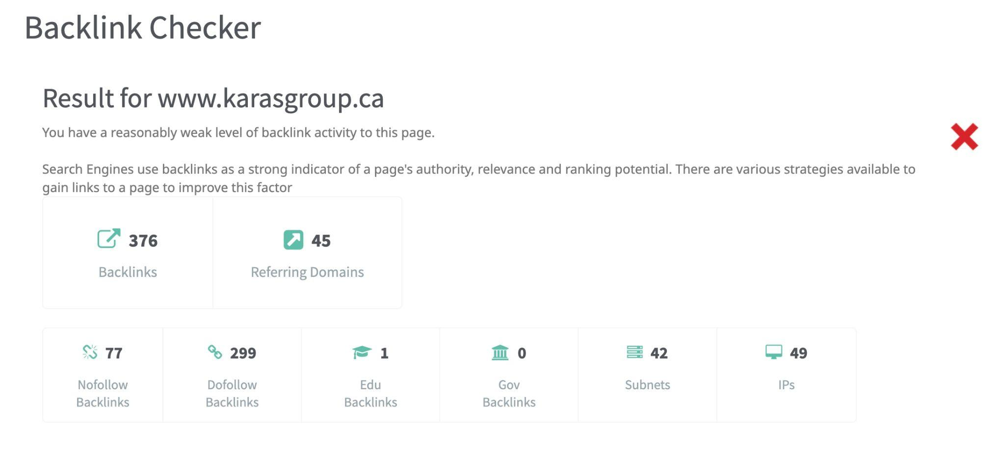
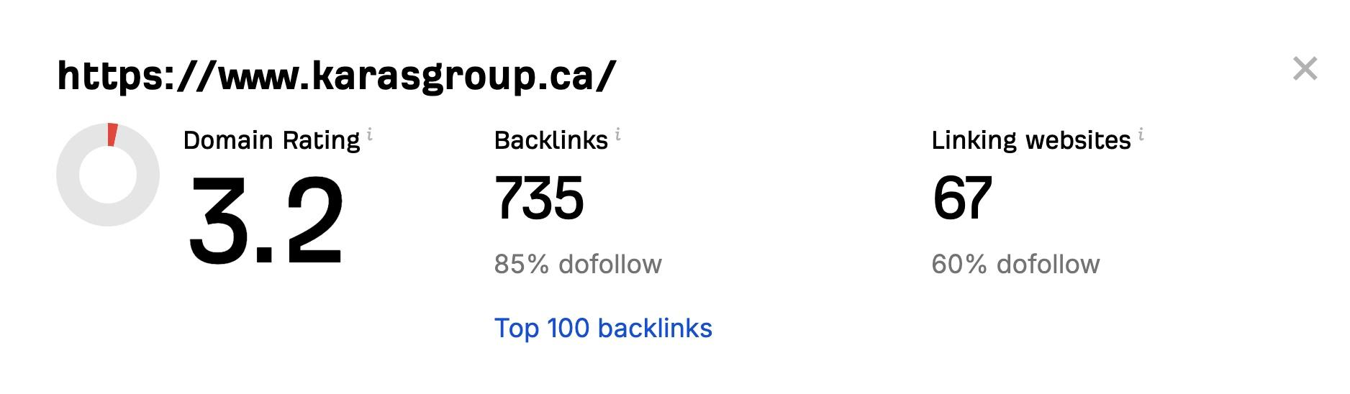
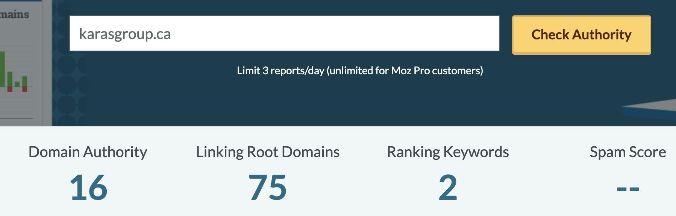
Karas Security: karasgroup.ca
Domain Authority & Page Authority
Please click here for a detailed report.

Slide 10
Karas Security: karasgroup.ca
Scope of Improvement
Website Design: While functional, the website could benefit from a more modern and visually appealing design. Consider incorporating bolder fonts, a refreshed color palette, and high-quality imagery.
Content Depth: While the initial information is clear, some sections lack detailed explanations of specific services and their benefits. Consider adding case studies, service brochures, or FAQs to provide more in-depth information.
SEO Optimization: Implement relevant keywords and meta descriptions throughout the website to improve search engine ranking and organic traffic.
Social Media Integration: Add social media icons and links to relevant profiles to encourage engagement and build online presence.
Blog or News Section: Consider incorporating a blog or news section to showcase industry expertise, share security tips, and attract organic traffic.
Career Information: Provide more detailed information about career opportunities, including specific job descriptions, benefits, and company culture.
Additional Notes:
The "News & Articles" section could benefit from more frequent updates and relevant content.
Consider adding client logos or case studies relevant to specific industries served.

Slide 11
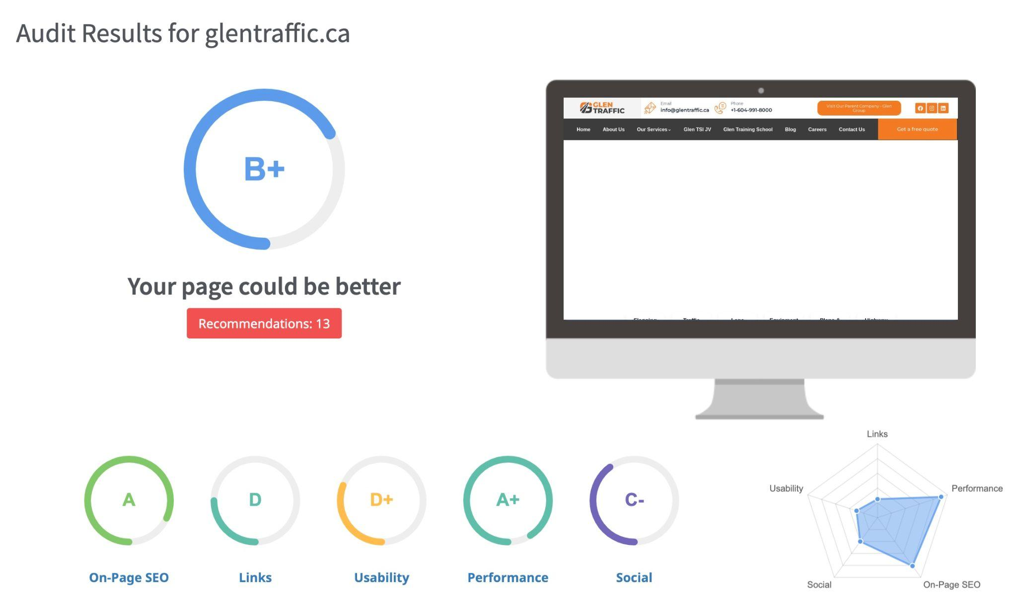
Glen Traffic: glentraffic.ca
Strengths and Analysis
Clear Value Proposition: The website effectively showcases Glen Traffic's commitment to safety, efficiency, and innovation in traffic management, emphasizing their diverse range of services.
Strong Brand Identity: Consistent branding throughout the website, including logos, colors, and fonts, creates a professional and unified image.
Compelling Visuals: High-quality images and videos showcasing projects and equipment add credibility and engage visitors.
Detailed Service Pages: Each service page provides clear descriptions, project examples, and benefits, helping potential clients understand the value Glen Traffic offers.
Call to Action: Prominent calls to action encourage users to contact for quotes, download resources, or request free consultations.
Please click on the image above for a detailed report.

Slide 12
Glen Traffic: glentraffic.ca
Scope of Improvement
Website Speed: Page loading times could be improved, especially on mobile devices. Consider optimizing images and implementing caching mechanisms.
SEO Optimization: While keywords are present, some pages could benefit from further optimization for relevant search terms. Consider implementing proper meta descriptions, title tags, and internal linking strategies.
Blog or News Section: Incorporating a blog or news section with industry insights, project updates, and safety tips can improve organic traffic and establish Glen Traffic as a thought leader.
Client Testimonials: Adding prominent testimonials from satisfied clients can further build trust and credibility.
Social Media Integration: Increase social media engagement by integrating icons and links to relevant profiles. Consider sharing website content and engaging with followers.
Contact Form Optimization: The contact form could be enhanced by including dropdown menus for service selection or adding location options for regional inquiries.
Additional Notes:
The "Careers" section could benefit from more detailed information about available positions, company culture, and employee benefits.
Consider adding awards or certifications received by Glen Traffic to further showcase their expertise and commitment to quality.

Slide 13
Glen Recruiters: glenrecruiters.ca
Strengths and Analysis
Clear Value Proposition: The website effectively communicates Glen Recruiters' focus on connecting talented individuals with top companies across Canada, emphasizing their personalized approach and proven track record.
Strong Calls to Action: Prominent calls to action encourage job seekers to submit their resumes, contact for career guidance, and explore job openings.
Diverse Job Listings: The website features a wide range of job openings across various industries, providing ample opportunities for potential candidates.
Easy Navigation: The website structure is clear and intuitive, with quick access to relevant information for both candidates and employers.
Mobile-Friendly Design: The website adapts well to mobile devices, ensuring accessibility on various platforms.
Please click on the image above for a detailed report.

Slide 14
Glen Recruiters: glenrecruiters.ca
Scope of Improvement
Website Design: While functional, the website could benefit from a more modern and visually appealing design. Consider incorporating fresh visuals, bolder fonts, and color palettes that align with the company's brand identity.
Content Depth: Some sections lack detailed information about specific services offered, particularly for employers. Consider adding case studies, client success stories, or service brochures to showcase expertise and value.
Employer Resources: Provide more resources for employers, such as hiring guides, salary benchmarking tools, or employer testimonials, to attract and retain them as clients.
Blog or News Section: Incorporating a blog or news section with industry insights, recruitment trends, and career advice can attract organic traffic, establish Glen Recruiters as a thought leader, and engage both candidates and employers.
Additional Notes:
Consider adding a section for international candidates seeking opportunities in Canada.
The "About Us" section could benefit from a video or short animation introducing the team and company culture.
Consider offering a candidate portal with resume management tools and job application tracking features.

Slide 15
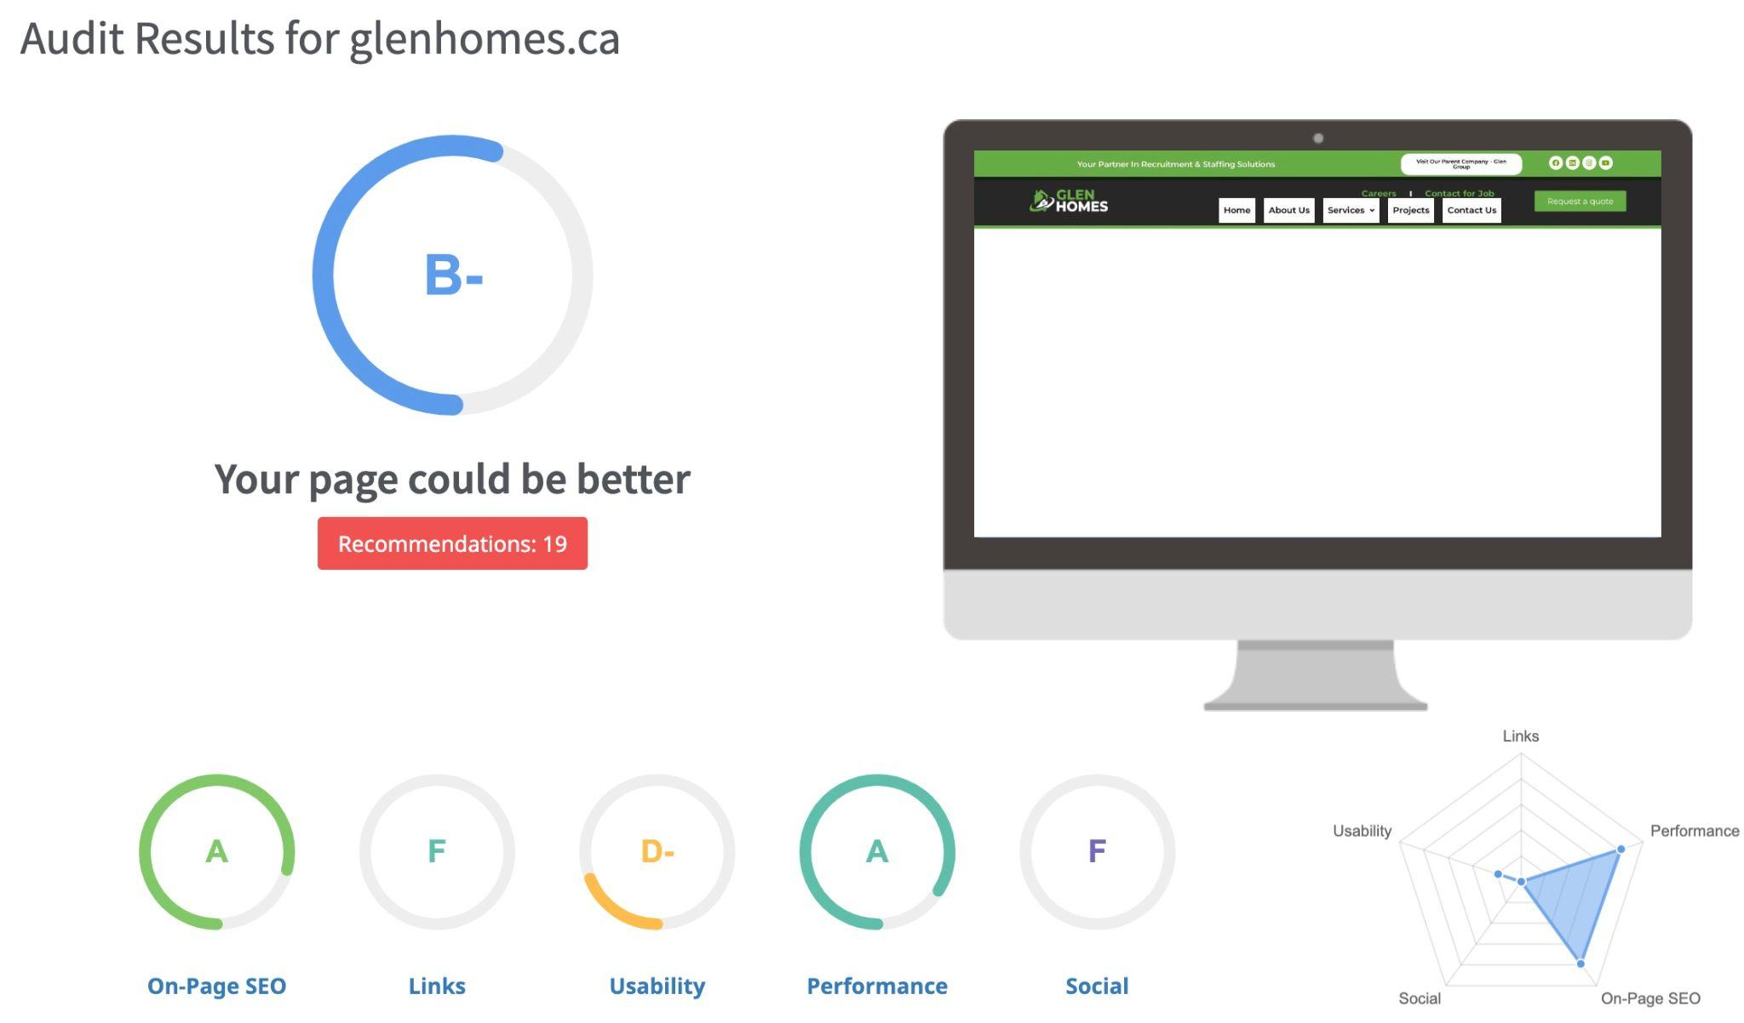
Glen Recruiters: glenhomes.ca
Strengths and Analysis
Clear Value Proposition: The website effectively emphasizes Glen Homes' commitment to building custom homes and renovations that reflect individual client dreams and exceed expectations.
High-Quality Visuals: Stunning photographs showcase the company's craftsmanship and attention to detail, drawing users in and building trust.
Diverse Service Portfolio: The website clearly outlines a wide range of services, from custom homes and renovations to laneway homes and commercial tenant improvements.
Easy Navigation: The website is well-structured and intuitive, with clear menus and quick access to relevant information for each service.
Mobile-Friendly Design: The website adapts well to various screen sizes, ensuring accessibility on mobile devices.
Please click on the image above for a detailed report.

Slide 16
Glen Recruiters: glenhomes.ca
Scope of Improvement
Content Depth: Some sections lack detailed information about specific services, benefits, and the construction process. Adding case studies, project breakdowns, or service brochures could enhance transparency and value perception.
Call to Action: While calls to action are present, they could be more prominent and persuasive. Encourage users to contact for consultations, request quotes, or download informative resources.
SEO Optimization: Implement relevant keywords and meta descriptions throughout the website to improve organic search ranking and attract potential clients.
Social Media Integration: Increase social media presence by adding prominent icons and links to relevant profiles. Share project updates, client testimonials, and industry insights to engage followers and build brand awareness.
Project Portfolio: Expand the project portfolio section with more detailed descriptions, high-quality photos from various stages of construction, and interactive elements like 3D tours.
Blog or News Section: Incorporating a blog or news section with industry trends, design tips, and project spotlights can attract organic traffic, establish Glen Homes as a thought leader, and engage potential clients.
Additional Notes:
Consider offering virtual consultations or online project management tools to cater to a wider audience and enhance convenience.

Slide 17

02
Social Media Analysis

Slide 18
Social Media Report
Instagram
Facebook
While the Instagram handles for Glen Groups look aesthetically pleasing, however the engagement rate is extremely less.
Facebook has the similar problem as Instagram, although the engagement rate expected on Facebook is less but the page lacks engaging content.
LinkedIn
YouTube
Handle other than Glen Recruiters need immediate attention, the posts are less engaging, doesn’t have versatility, less informative and needs collaboration from the teams and founders.
YouTube channel has the least subscriber and needs the most work as there is barely few pieces of content that provided information and engagement.

Slide 19
Plan of Action for Improvement
LinkedIn:
1. Optimize Company Page: Complete the LinkedIn company pages with a compelling description and relevant keywords.
2. Share Industry Insights: Share valuable articles and insights relevant to your audience.
3. Employee Advocacy: Encourage employees to share company updates and industry content.
4. Create Visual Content: Use infographics, slideshows, and videos for better engagement.
Instagram:
1. Visual Storytelling: Showcase products/services creatively through visual content.
2. Use Hashtags: Research and use industry-specific hashtags for increased discoverability.
3. Highlight Success Stories: Share success stories and client testimonials through carousel posts.
Facebook:
1. Varied Content: Mix up content types with images, videos, links, and text updates.
2. Join Facebook Groups: Participate in relevant industry groups and share insights.
3. Advertise Strategically: Use Facebook Ads to target specific B2B audiences.
YouTube:
1. Educational Videos: Create educational videos about the different industries, products, and services.
2. Webinar Recordings: Repurpose webinar content into YouTube videos.
3. Collaborate: Collaborate with influencers or other businesses in your industry.

Slide 20

03
Target Audience

Slide 21
Target Audiences
Karas Security: Karas Security provides customized and cutting-edge security solutions for residential and commercial properties, as well as special events. The target audience could be homeowners, business owners, event planners, and anyone who values safety and security.
Glen Group of Companies: Glen Group of Companies is a multi-faceted company that offers a range of services, including security, real estate, recruitment, childcare, traffic management, and home renovations. The target audience could be individuals, families, and businesses looking for reliable and professional services in these areas.
Glen Recruiters: Glen Recruiters is a recruitment agency that specializes in connecting talented individuals with excellent companies across various industries. The target audience could be companies looking for the right addition to their team.
Glen Homes: Glen Homes provides construction services, specializing in laneway homes, custom single and multi-family homes, and renovations. The target audience could be homeowners looking to build or renovate their homes.
Glen Traffic Solutions: Glen Traffic Solutions is a traffic management company that provides safe and efficient traffic management solutions for construction zones and other areas. The target audience could be construction companies, event planners, and municipalities.

Slide 22
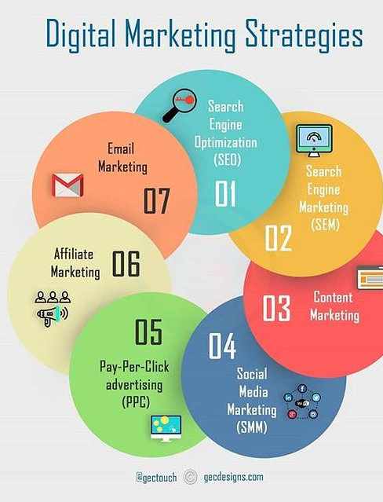
04
Marketing Strategy

Slide 23
Key Areas to Work
Social Media Marketing
Content Marketing
Performance Marketing
A robust social media strategy will be developed to promote Glen Group and its verticals to build digital presence, engage with audience, and build brand authority
All the business verticals need heavy amount of content and blogs to grow ranking and give brand the visibility and gain traction organically with intent to conversion
Paid marketing is much needed for any business to generate valuable leads and conversions, although this step can be taken after 1 month of digital presence building exercises
Email Marketing
Seminar, Expo, Podcasts
Video Content Creation
Email marketing is the most effective and underrated tactic to grow businesses, as the model is free of cost, email marketing can help generate more leads and build client relationship.
Video form of content is the most powerful tool to communicate the brand’s objective and to educate the audience, it is also the most engaging form of content.
Participating in physical expo, digital podcasts and seminar gives the organization golden leads and the opportunity to collaborate. The same content can be reused digitally to build presence.

Slide 24
Timeline to achieve Goals
1 month
3 month
6 month
1 year
Build good and authentic digital presence of all the social media handles as well as the website
Start converting the leads into sales
Maintain quality relationship with the new and existing clients
Represent Client journey, look for new business opportunities and incorporate with the growing technology

Slide 25
Marketing Strategies
Karas Security: Karas Security could benefit from a digital marketing strategy that focuses on search engine optimization (SEO), social media marketing, and email marketing. SEO can help improve their website's visibility on search engines, while social media and email marketing can help them reach out to potential clients and keep existing clients engaged.
Glen Group of Companies: Glen Group of Companies could benefit from a digital marketing strategy that focuses on content marketing, social media marketing, and influencer marketing. Content marketing can help them establish themselves as thought leaders in their respective industries, while social media and influencer marketing can help them reach out to a wider audience and build brand awareness.
Glen Recruiters: Glen Recruiters could benefit from a digital marketing strategy that focuses on search engine marketing (SEM), social media marketing, and email marketing. SEM can help them reach out to businesses who are actively looking for recruitment agencies, while social media and email marketing can help them build relationships with potential candidates and keep them engaged.
Glen Homes: Glen Homes could benefit from a digital marketing strategy that focuses on content marketing, social media marketing, and email marketing. Content marketing can help them showcase their expertise in the construction industry, while social media and email marketing can help them reach out to potential clients and keep existing clients engaged.
Glen Traffic Solutions: Glen Traffic Solutions could benefit from a digital marketing strategy that focuses on search engine optimization (SEO), social media marketing, and email marketing. SEO can help improve their website's visibility on search engines, while social media and email marketing can help them reach out to potential clients and keep existing clients engaged.

Slide 26

05
Resources

Slide 27
Resources:
(1) Digital Marketing - Security Guard Services in Canada. https://www.karasgroup.ca/services/digital-marketing/.
(2) Unlocking Success: The Inspiring Journey of Glen Group of Companies .... https://glengroup.ca/blog/unlocking-success-the-inspiring-journey-of-glen-group-of-companies/.
(3) The Ultimate Guide to Marketing Strategies & How to Improve Your .... https://blog.hubspot.com/marketing/digital-strategy-guide.
(4) About Us – Glen Homes. https://glenhomes.ca/about-us/.
(5) Unlock Your Hiring Success with the Best Employment Agency in canada!. https://glenrecruiters.ca/.
(6) About Karas Security | Company Providing Security Services. https://www.karasgroup.ca/about-us/.
(7) Unlock Security Excellence with Karas: Your Trusted Security Company. https://www.karasgroup.ca/.
(8) Exploring Successful Group of Companies: A Case Study - glengroup.ca. https://glengroup.ca/blog/exploring-successful-group-of-companies-a-case-study/.
(9) Glen Group Of Companies - About Us. https://glengroup.ca/about/.
(10) Unparalleled Traffic Management Solutions | Trusted Experts. https://glentraffic.ca/.
(11) About Us - Glen Traffic Solutions Inc.. https://glentraffic.ca/about-us/.
(12) The Ultimate Guide to Efficient - glentraffic.ca. https://glentraffic.ca/the-ultimate-guide-to-efficient-traffic-management-services/.
(13) About Us - Glen Recruiters. https://glenrecruiters.ca/about-us/.
(14) Executive Hiring: Transforming Businesses with Top Talent - Glen Recruiters. https://glenrecruiters.ca/service/executive-hiring/.
(15) Digital Marketing Strategies: 11 Essential Marketing Tips. https://business.adobe.com/blog/basics/digital-marketing-strategy.
(16) Glen Homes – Home Renovation Experts. https://glenhomes.ca/.
(17) SEOptimer.com

Slide 28

Thank You
Do you have any questions?
srijan.web3@gmail.com | +919179585554|

